Slide 1

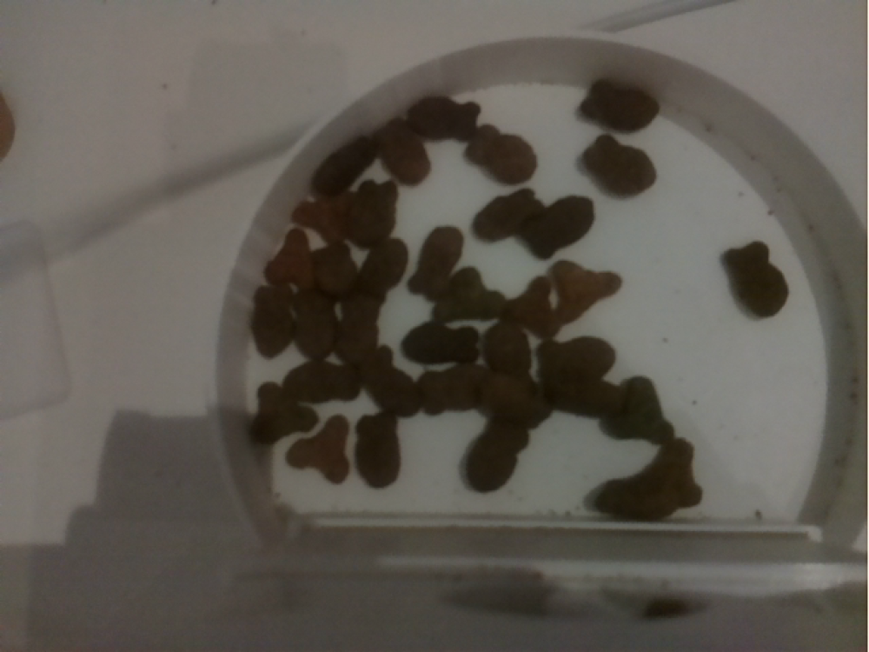
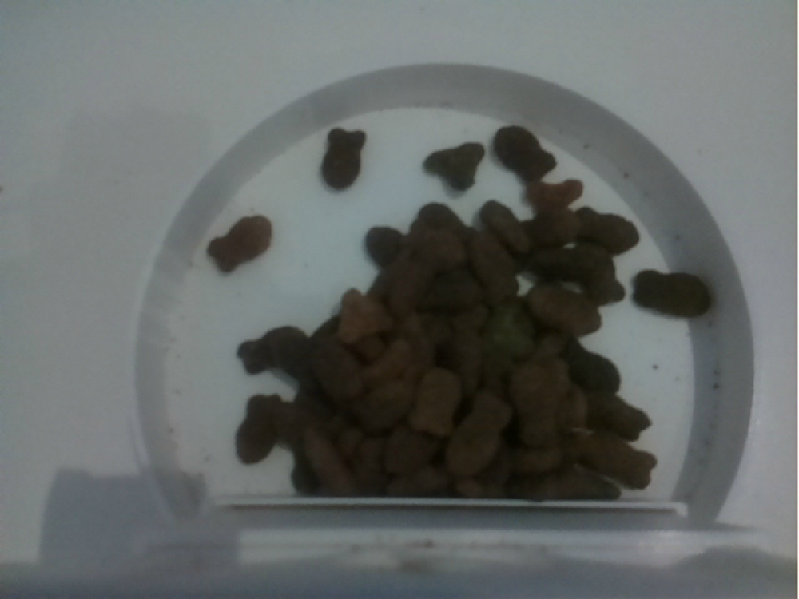
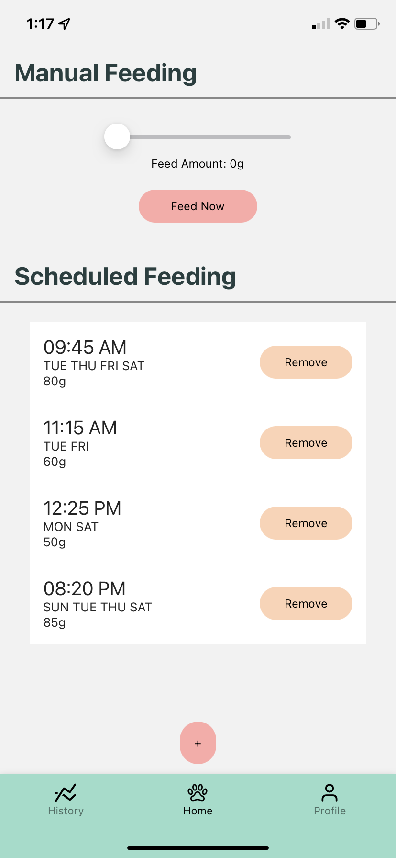
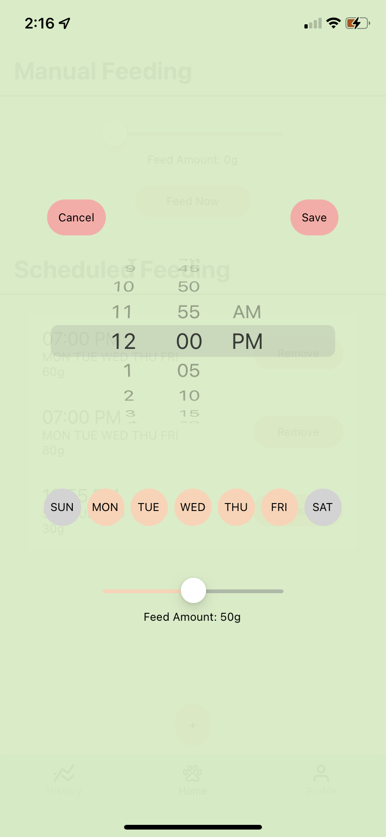
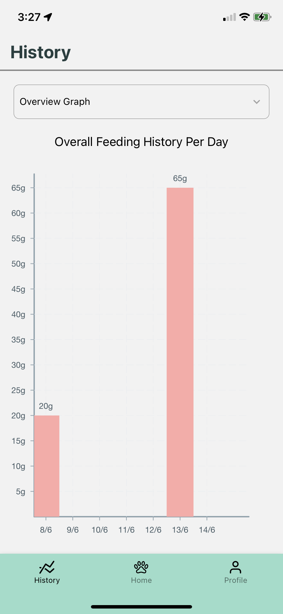
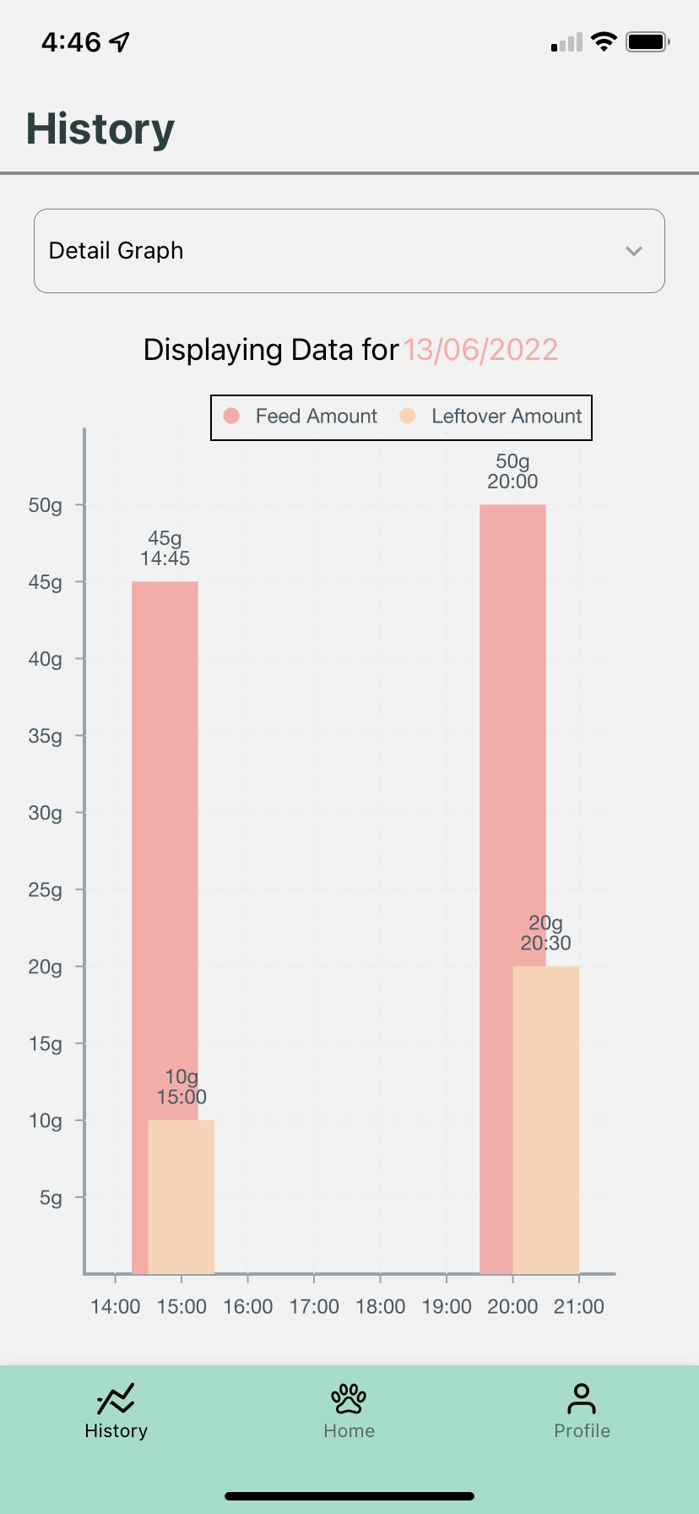
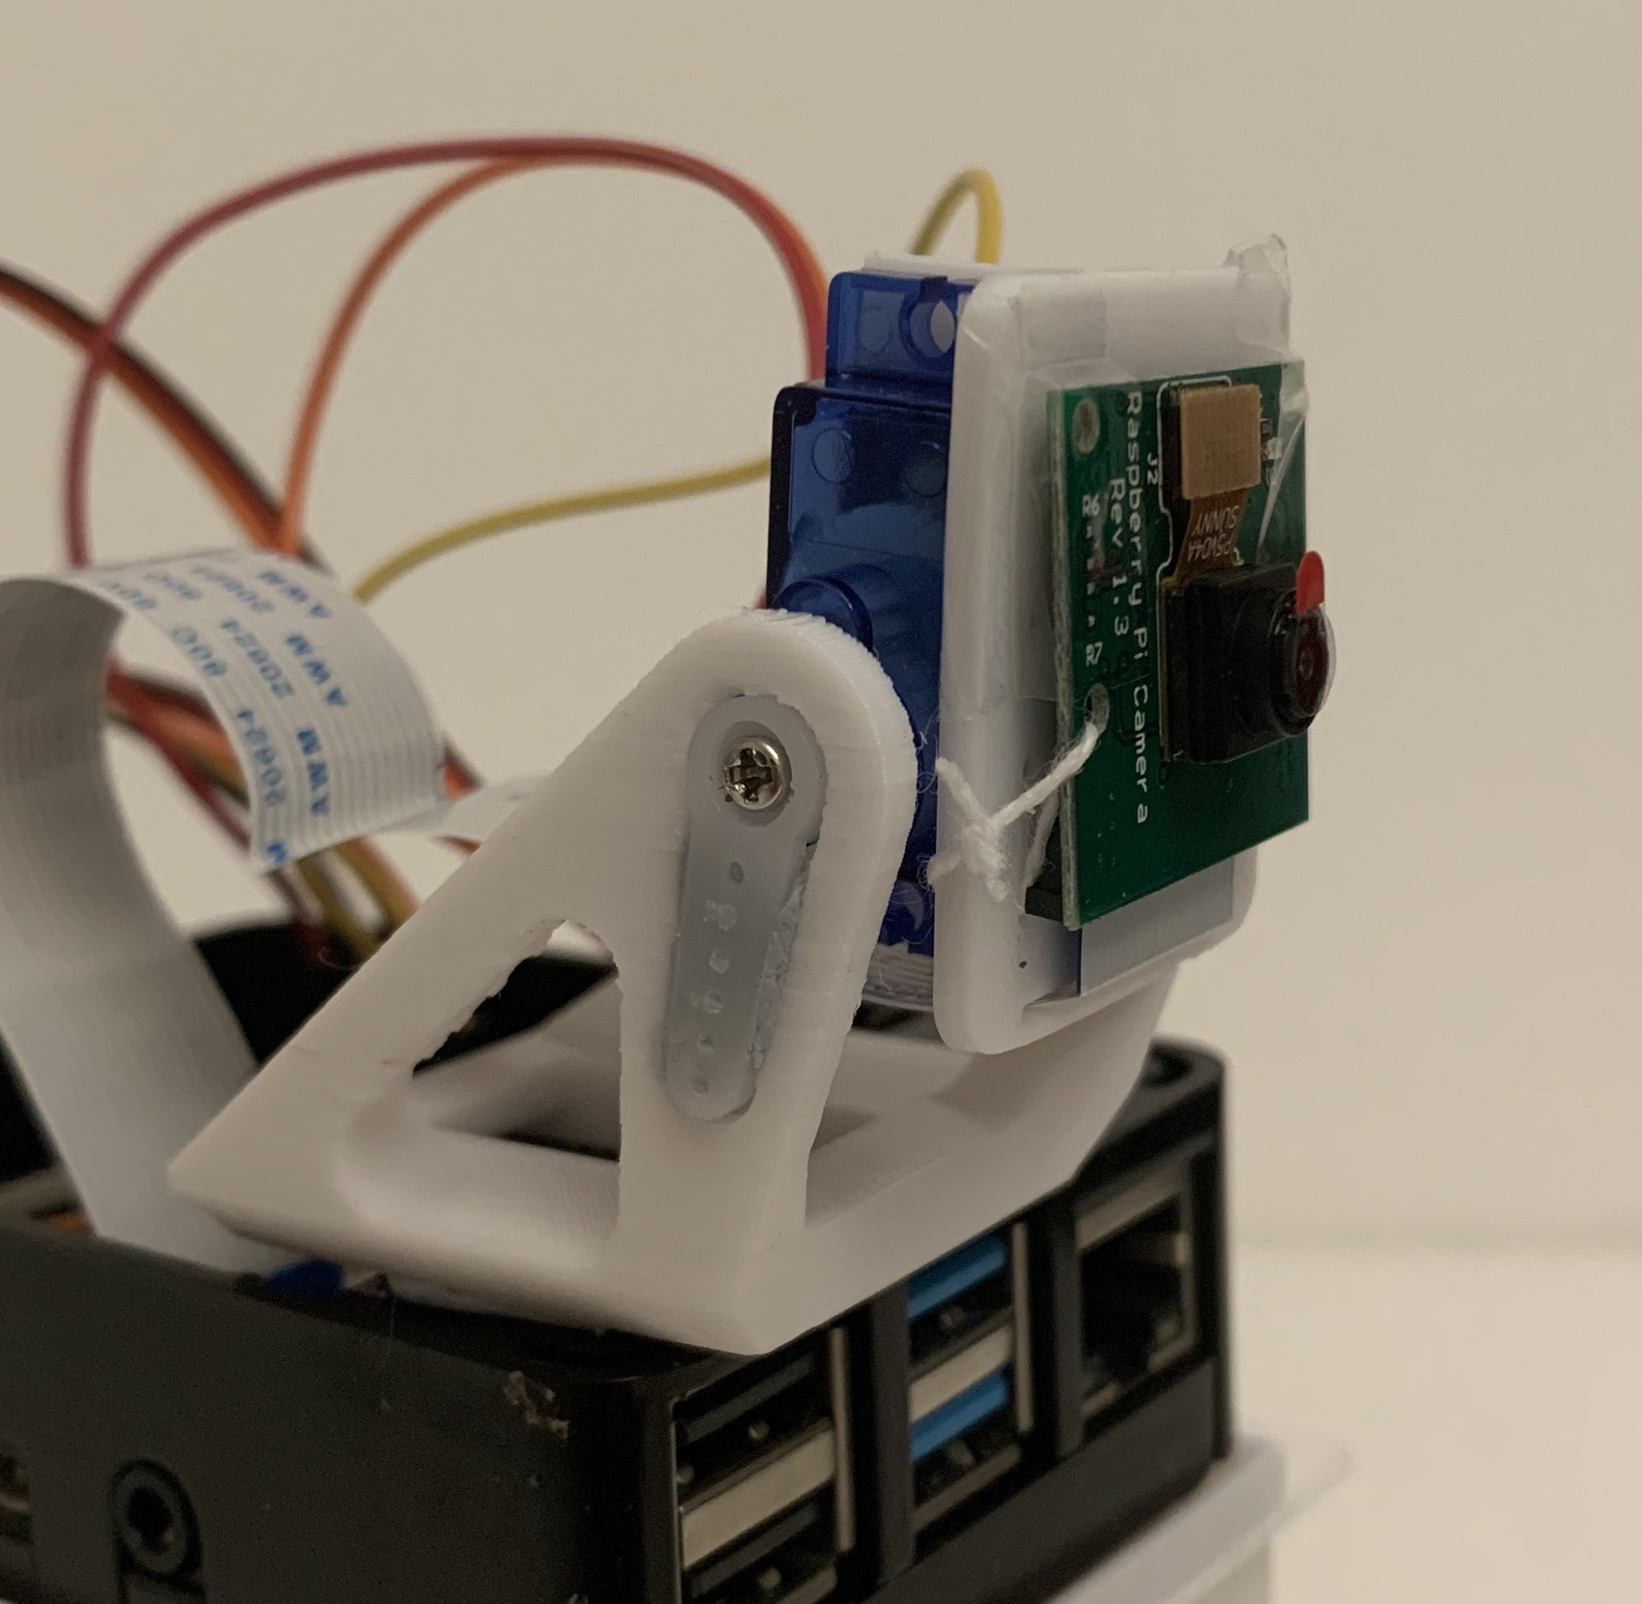
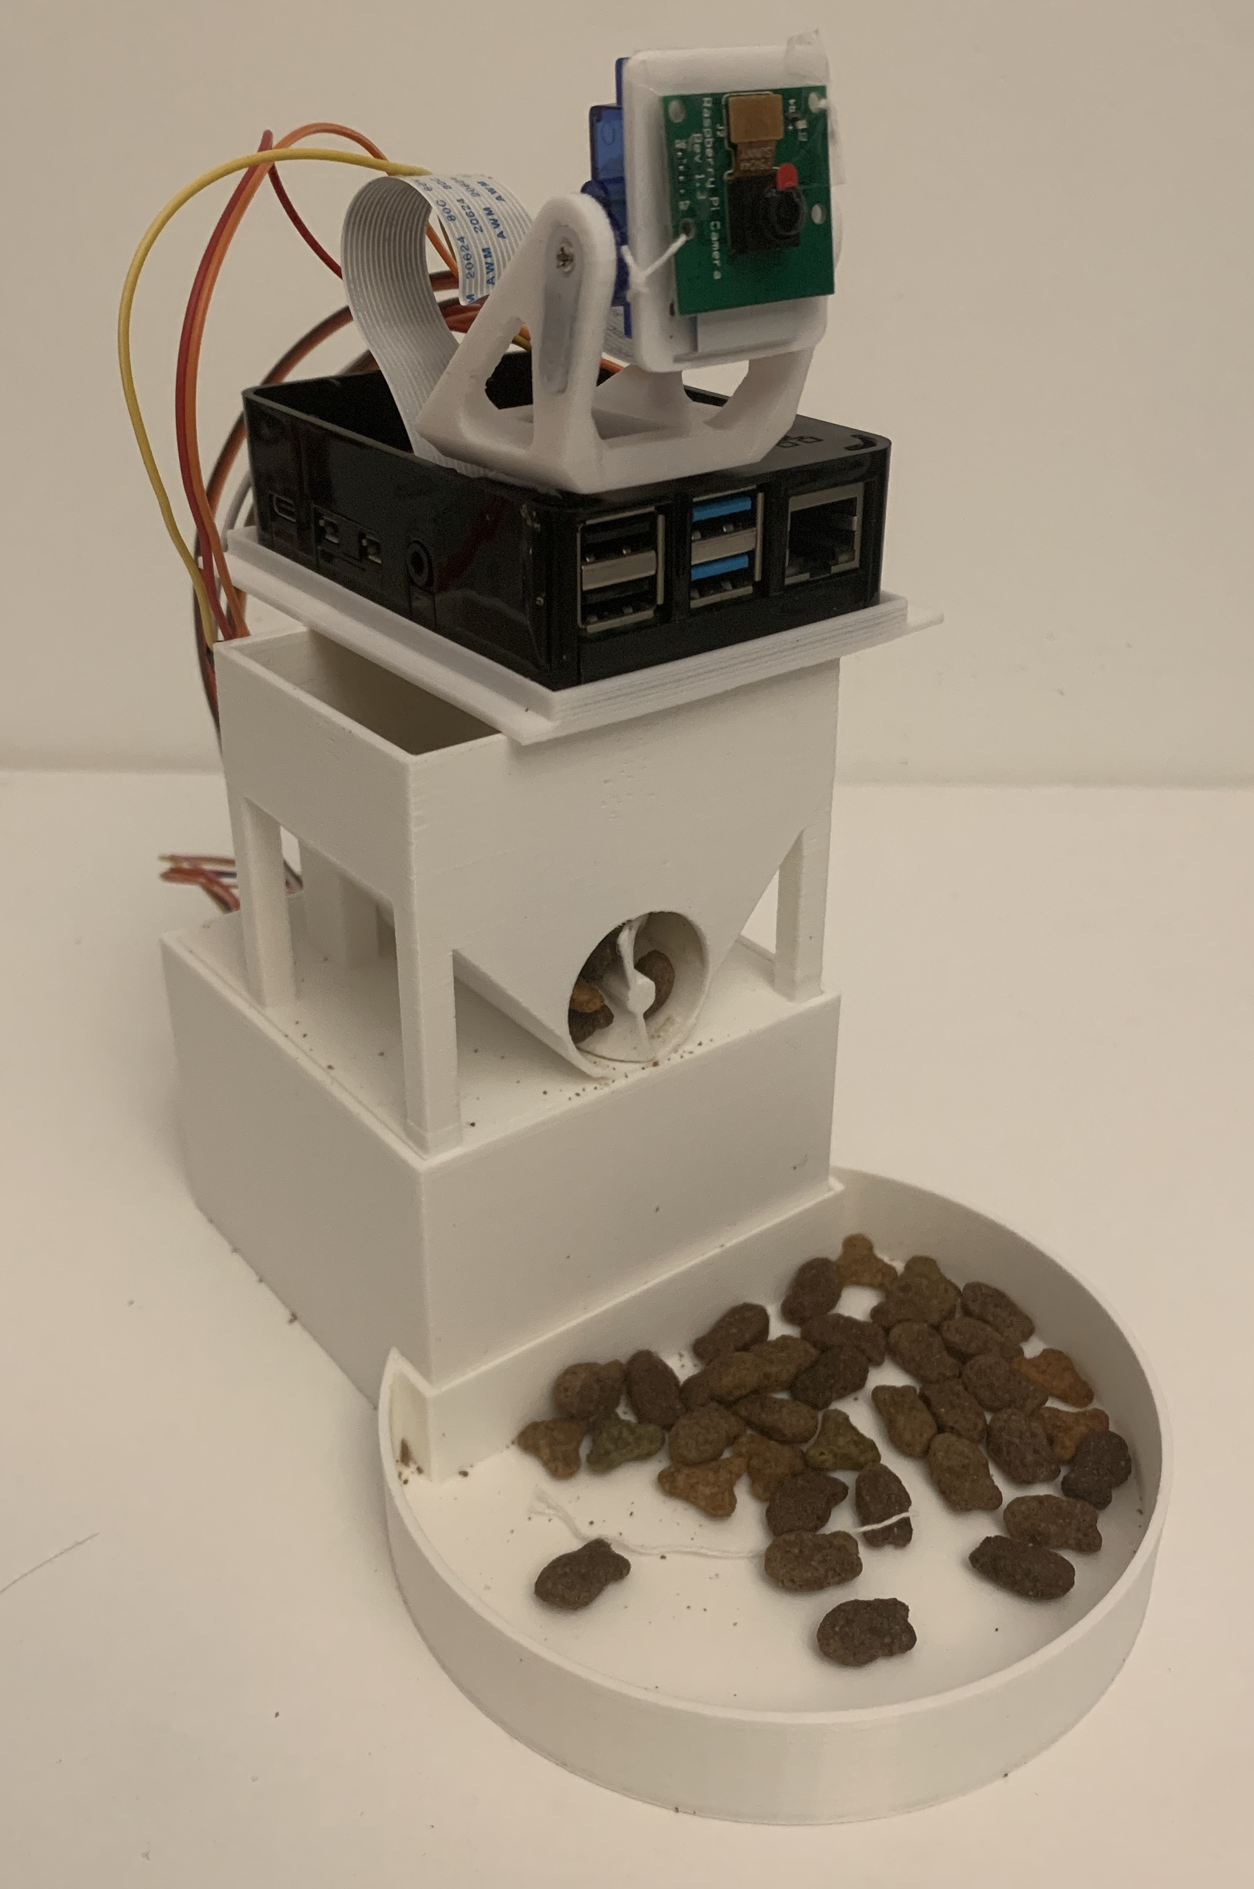
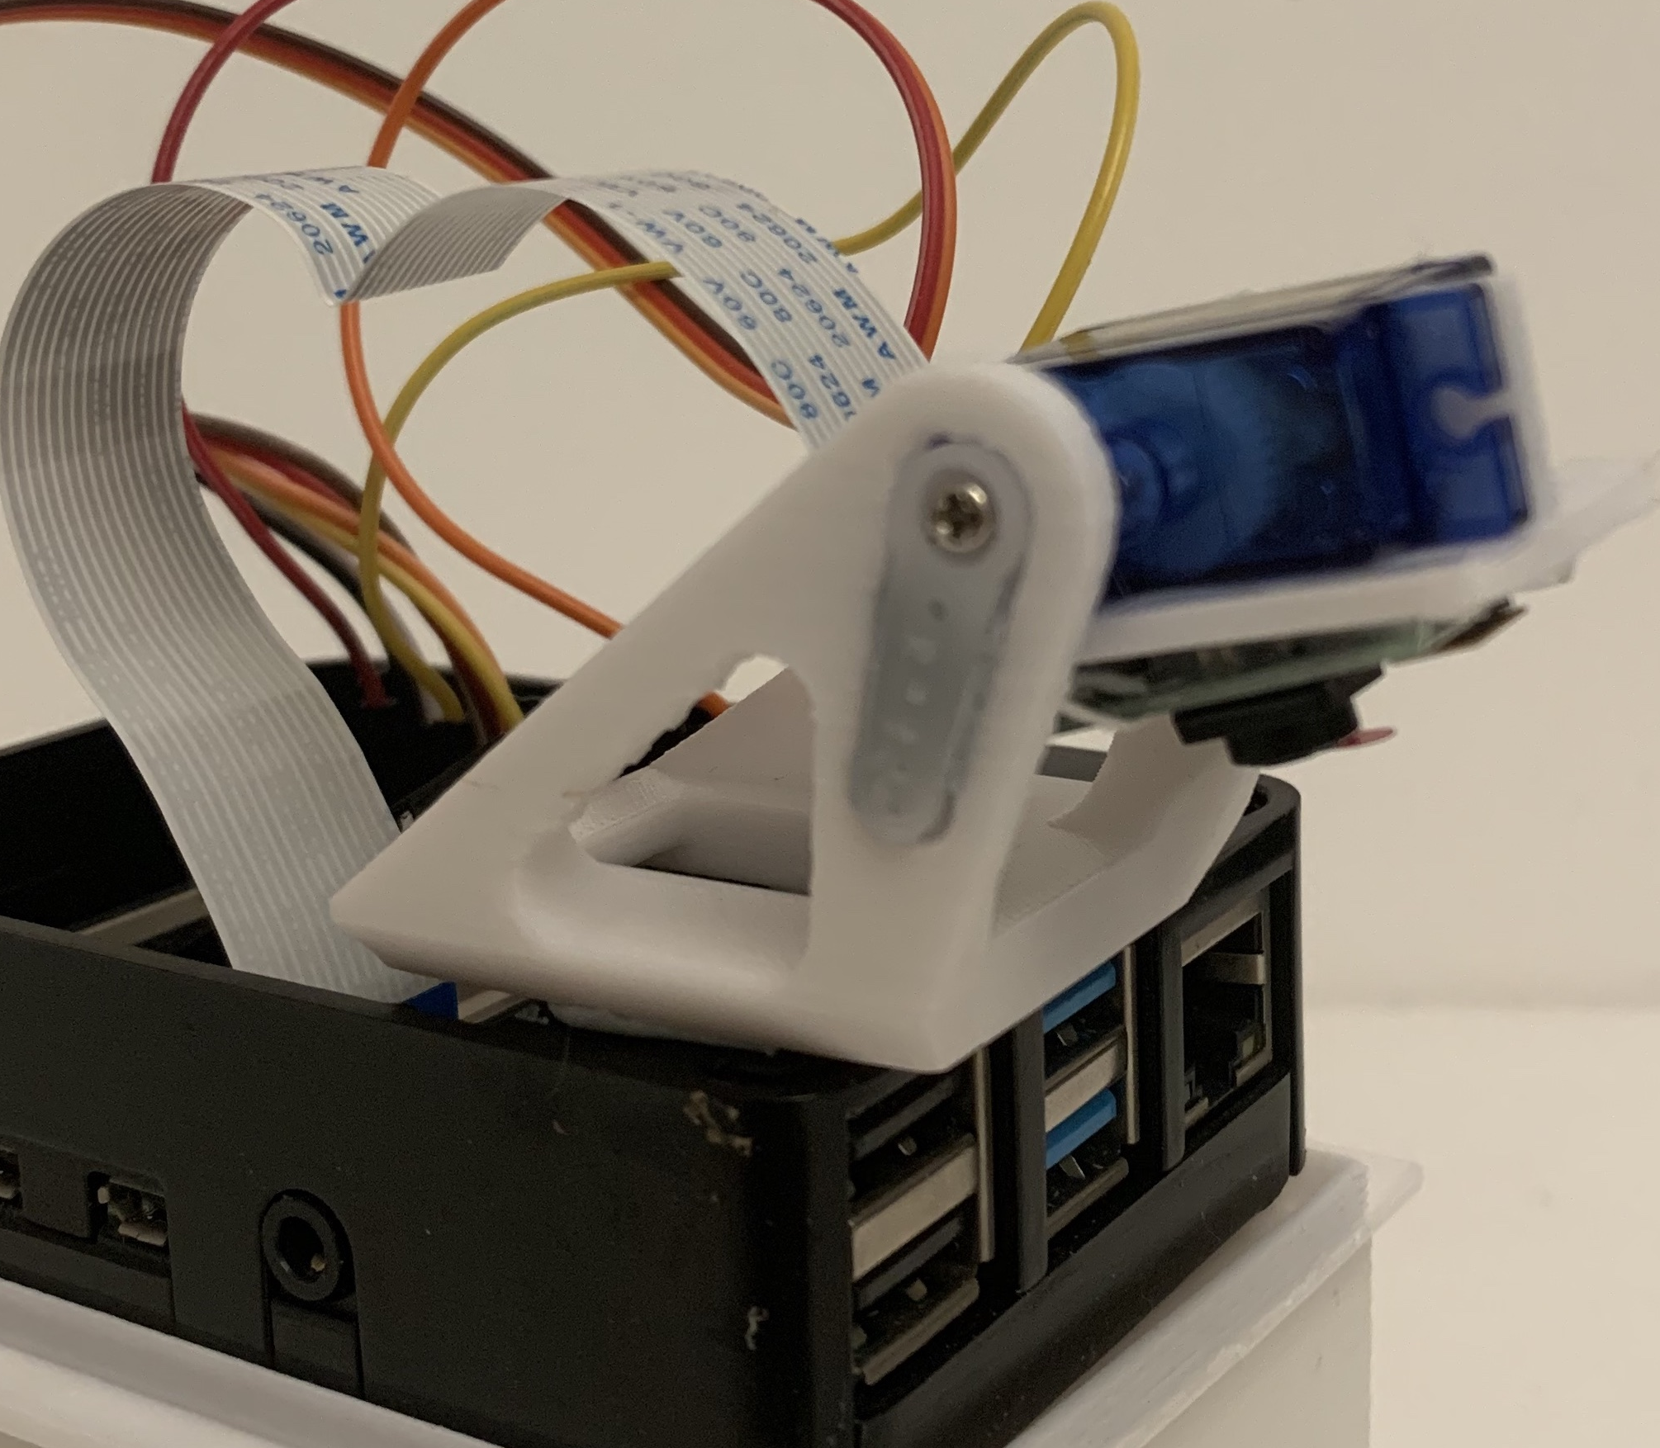
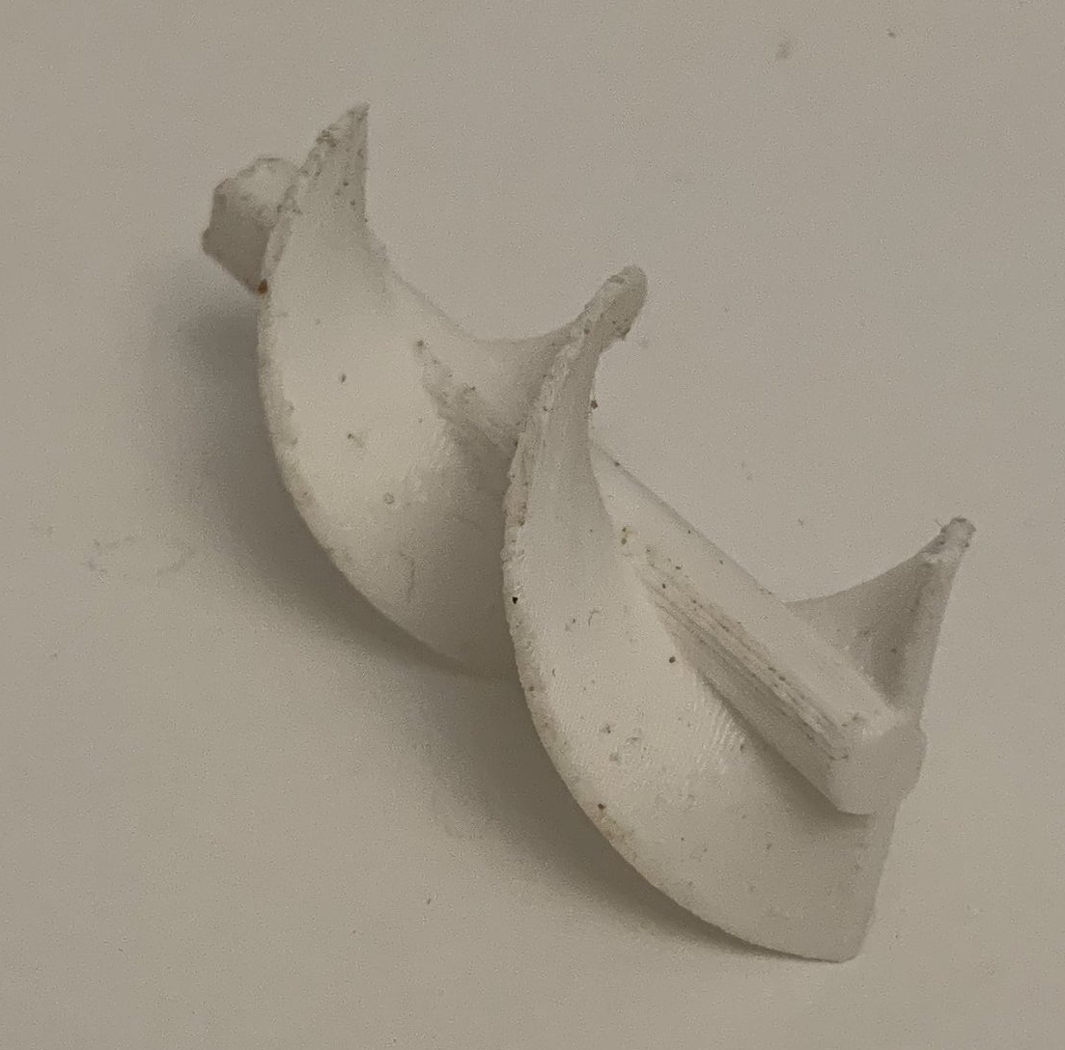
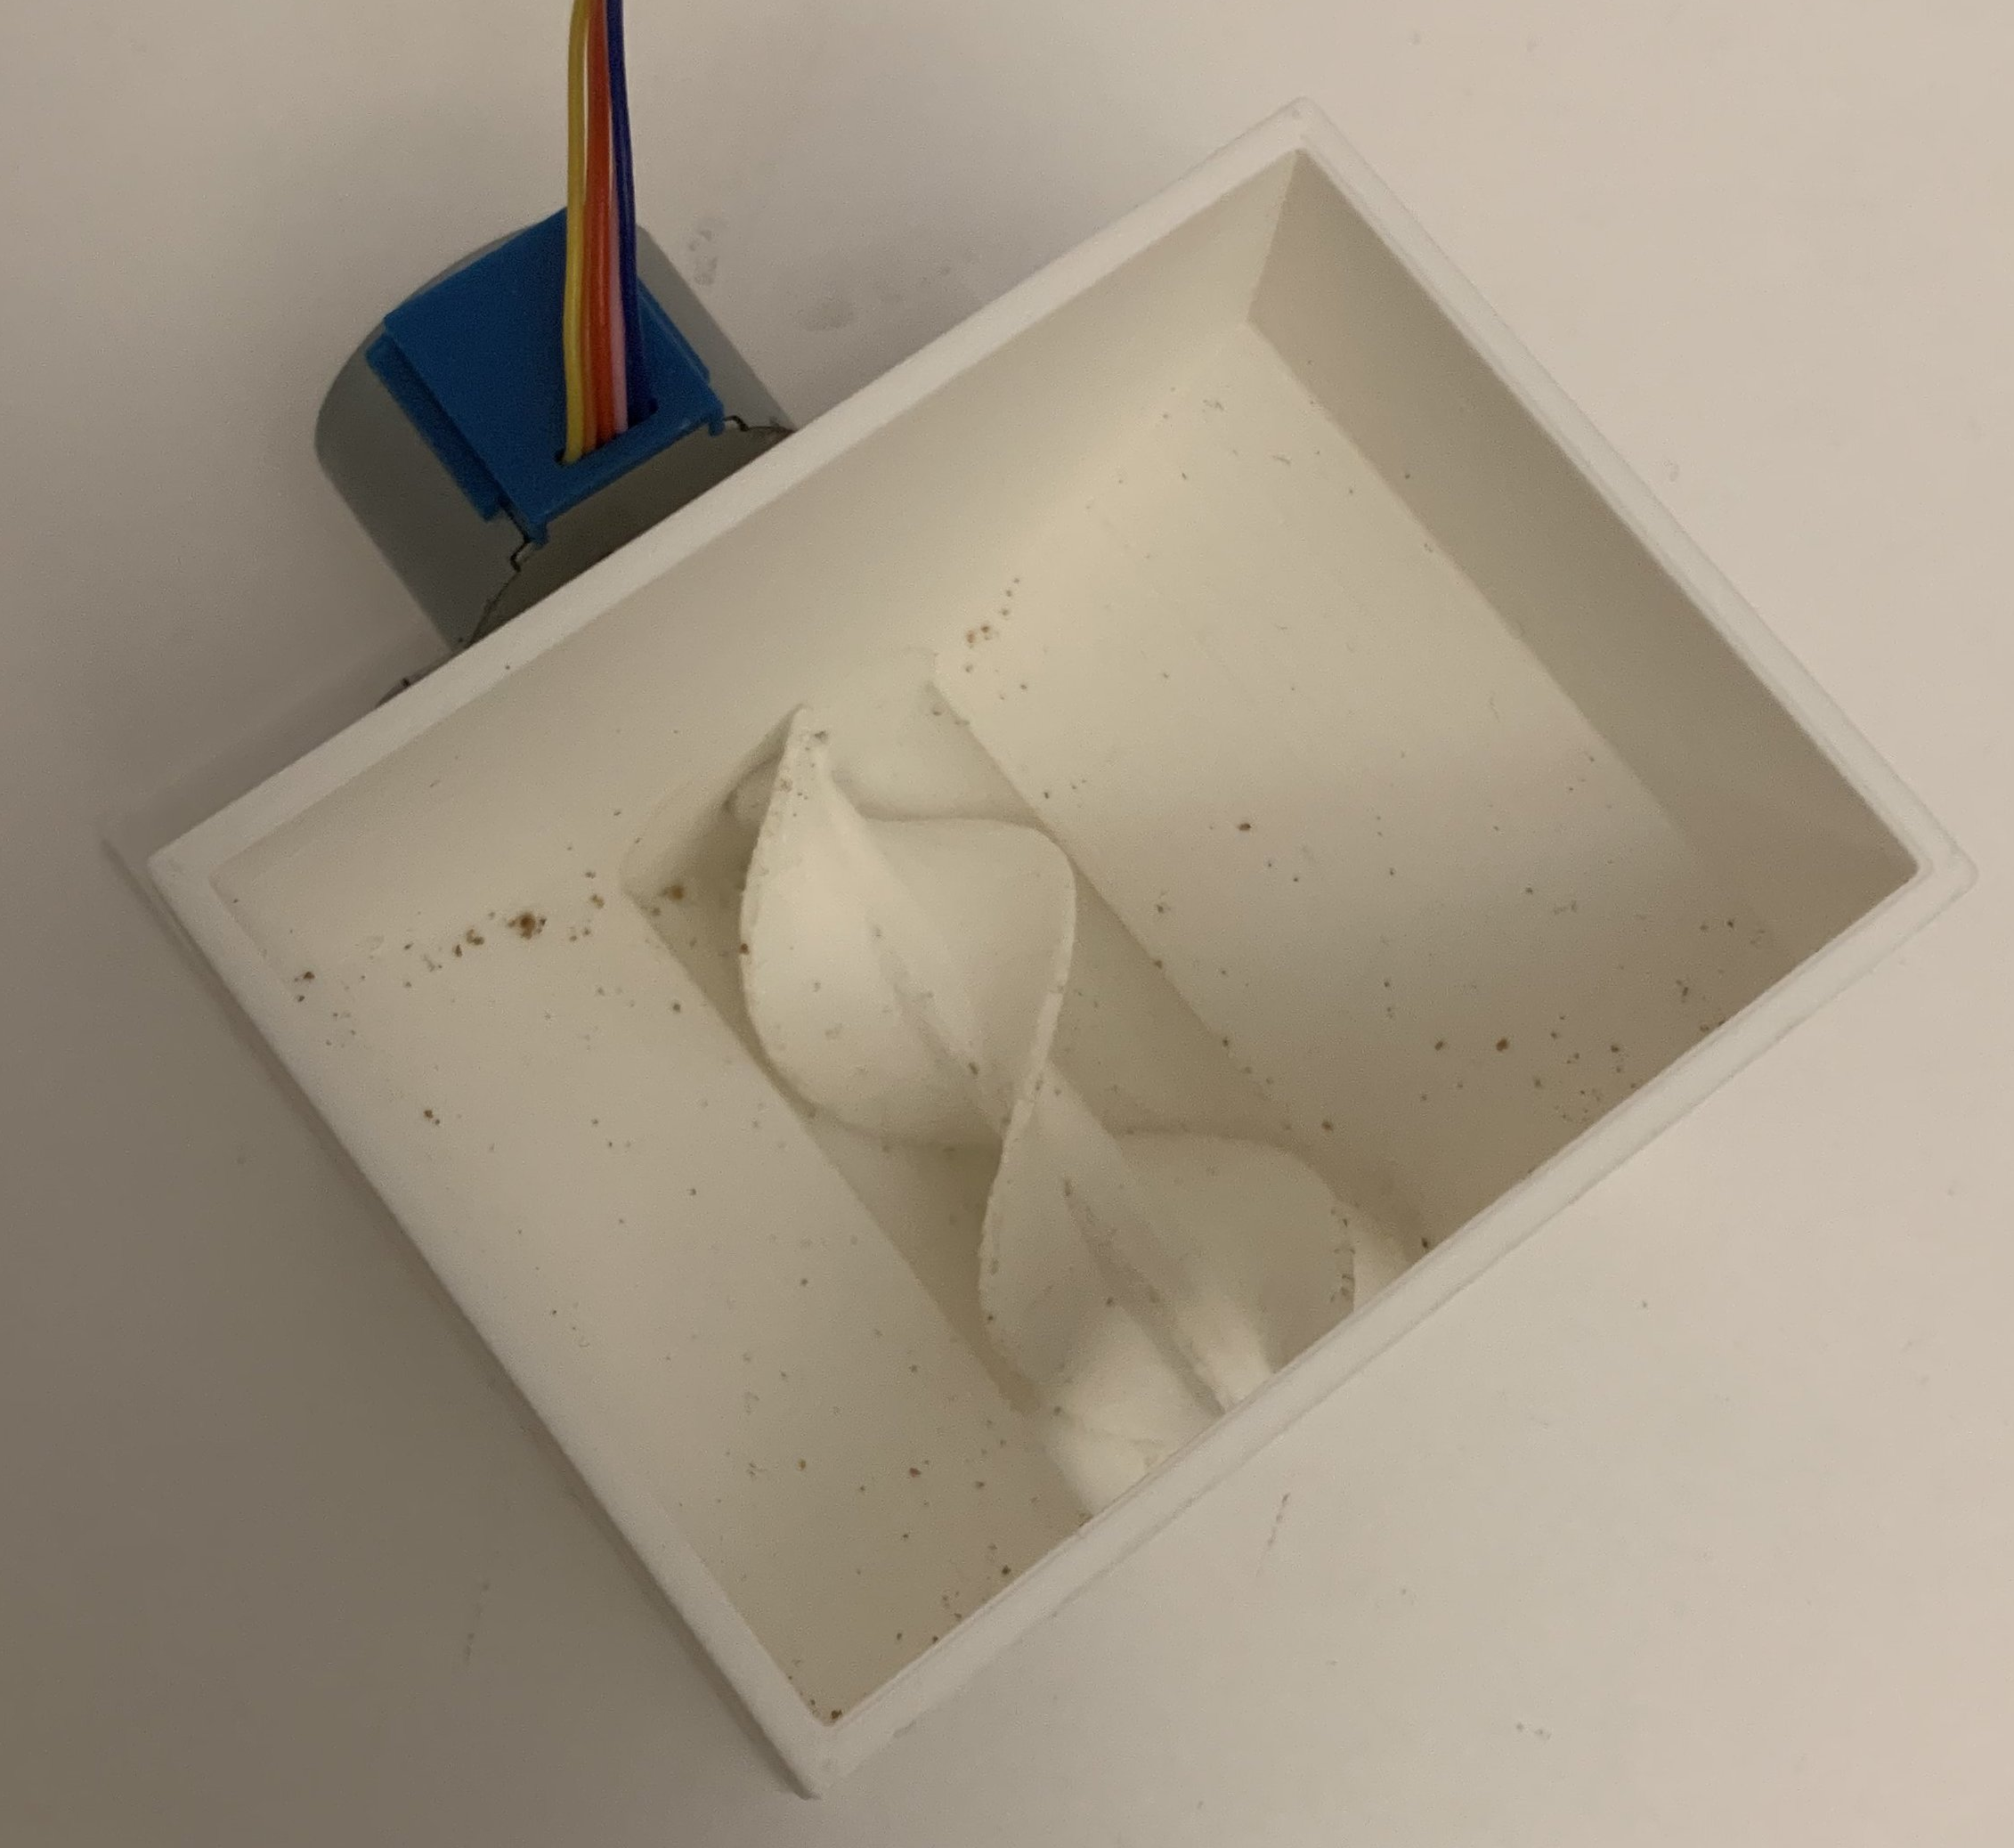
A SMART PET FEEDER
Siting Zhao
INTRODUCTION
Pets are slowly starting to become a part of every household, with an estimate of 59% of households in the United Kingdom owning pets [1], a 14% increase since 2019 [2]. For a large majority of the working population, finding the time to care for a pet in the day would be more toilsome. This project aims to solve these issues using a smart pet feeder.
SOFTWARE IMPLEMENTATION
The mobile frontend is created using React Native and supports both iOS and Android devices.
PROJECT AIMS
The aim of this project is to design, build and test a smart pet feeder.
The project specifications are as follows:
Fully functional feeder prototype that can dispense varying number of pellets.
An accompanying mobile app that allows the user to specify a feeding schedule or manually begin feeding.
A graphical interface for viewing of historical feeding data that is stored in a fast and secure database.
Use of machine learning to estimate the number of pellets left in the food plate after feeding.
a) Actual: 32g; Estimated: 28.84g
b) Actual: 79g; Estimated: 81.54g
Figure 3. Input Images to the Model For Estimation
A camera mount that can be panned was printed and attached to the top of the prototype. The final prototype with the camera attached to its mount can be seen in Figure 4.
a) Main Page
b) Add Schedule Page
c) History Page
Figure 2. Main Pages of the Mobile Application
Figure 2a shows the main page that the user sees after logging in. On this page, the user can manually initiate feeding, or create a recurring feeding schedule.
The add schedule page shown in Figure 2b is a screen that pops up upon clicking the + button at the bottom of the main page. On this page, the user can configure their desired feeding schedule which will be added to the database.
The history page in Figure 2c displays the past feeding activity of the feeder in a graphical form.
HARDWARE IMPLEMENTATION
The feeder mechanism uses an auger-based design to dispense the pellets, up to a precision of 5g, as shown in Figure 1 below.
A Raspberry Pi was used as the microcontroller.
Figure 4. Camera Mount on Final Prototype
MACHINE LEARNING TO ESTIMATE NUMBER OF PELLETS IN THE PLATE
A machine learning model was trained using a self-collected dataset to estimate the number of pellets that are in the food plate.
Raspberry Pi (RPi) camera was used to capture images.
Hyperparameter tuning was performed to optimise the accuracy of the model.
The estimated number of pellets will be stored in the database and displayed on a detailed graph page, shown in Figure 5.
The model achieved a R2 score of 0.968, and root mean square error (RMSE) of 0.0554, which is equivalent to an uncertainty of 5g.
Figure 3 shows two sample inputs taken while using the product. It is labelled with its actual weight and the weight estimated by the model.
Figure 5. Detailed Graph Page
CONCLUSION
Overall, the product successfully met most of its specifications.
The estimate of the number of pellets remaining is a valuable feature as owners can use it to monitor the health of their pets.
User satisfaction regarding the app's ease of use was high, and its features received positive feedback.
Worst-case and average latency of frontend functions are within 10ms.
FUTURE WORK
Use an Infrared (IR) sensor to detect when the pet has finished eating.
Design an improved hardware that has all electronics hidden from sight.
Provide on-demand streaming using the Raspberry Pi camera.
Enable pairing between the mobile app and feeder prototype using Bluetooth or WiFi.
Figure 1. 3D Printed Auger-based Dispenser Mechanism
[1] P. F. M. Association, “Pet population 2021.” [Online]. Available: https://www.pfma.org.uk/pet-population-2021
[2] S. R. Department, “Pet ownership in the united kingdom (uk) 2011/21-2021/22,” Apr 2022. [Online]. Available: https://www.statista.com/statistics/308235/estimated-pet-ownership-in-the-united-kingdom-uk/

